Slide 1
Operating Systems
Chapter 2 (a)
Operating System Structures
Hammad Afzal
hammad.afzal@mcs.edu.pk
Computer Science Department
College of Telecommunication Engineering
National University of Sciences and Technology

Slide 2
Chapter 2: Roadmap
Operating System Services
User Operating System Interface
System Calls
Types of System Calls

Slide 3
Objectives
To describe the services an operating system provides to users, processes, and other systems
To discuss the various ways of structuring an operating system
To explain how operating systems are installed and customized and how they boot

Slide 4
Operating System Services
Operating systems provide an environment for execution of programs and services to programs and users of these programs.
One set of operating-system services provides functions that are helpful to the user and programmer:
Some of the functions provided by OS services are:
User interface
Program execution
I/O operations
File-system manipulation
Communications
Error Detections

Slide 5
Operating System Services
User interface - Almost all operating systems have a user interface (UI). Varies between Command-Line (CLI), Graphics User Interface (GUI), Batch
CLI: Mechanism to enter text commands and edit those commands
GUI: Window system with pointing device to direct I/O, choose from menus etc.
Program execution –
The system must be able to load a program into memory and to run that program, end execution, either normally or abnormally (indicating error)

Slide 6
Operating System Services
I/O operations
A running program may require I/O, which may involve a file or an I/O device. OS must provide way to deal with it.
File-system manipulation
The file system is of particular interest. Programs need to read and write files and directories, create and delete them, search them, list file Information, permission management.

Slide 7
Operating System Services (Cont.)
Communications
Processes may exchange information, on the same computer or between computers over a network
Communications may be via shared memory or through message passing (packets moved by the OS)
Error detection
OS needs to be constantly aware of possible errors
May occur in the
CPU and memory hardware (memory error or power failure),
In I/O devices (a parity error on tape, connection failure on network, lack of paper in printer),
In user program ( an arithmetic overflow, attempt to access illegal memory location)

Slide 8
Operating System Services (Cont.)
Error Detection (contd…)
For each type of error, OS should take the appropriate action to ensure correct and consistent computing. OS reaction to deal with errors vary.
Debugging facilities can greatly enhance the user’s and programmer’s abilities to efficiently use the system

Slide 9
Operating System Services (Cont.)
Another set of OS functions exists for ensuring the efficient operation of the system itself via resource sharing
Resource allocation - When multiple users or multiple jobs running concurrently, resources must be allocated to each of them
Many types of resources - Some (such as CPU cycles, main memory, and file storage) may have special allocation code, others (such as I/O devices) may have general request and release code
For example, to use CPU, OS have CPU scheduling routines that take into account speed of CPU, jobs that must be executed, number of registers available, and other factors.
Accounting - To keep track of which users use how much and what kinds of computer resources

Slide 10
Operating System Services (Cont.)
Protection and security
The owners of information stored in a multiuser or networked computer system may want to control use of that information,
Concurrent processes should not interfere with each other
Protection involves ensuring that all access to system resources is controlled
Security of the system from outsiders requires user authentication (by means of password), extends to defending external I/O devices from invalid access attempts
If a system is to be protected and secure, precautions must be instituted throughout it. A chain is only as strong as its weakest link.

Slide 11
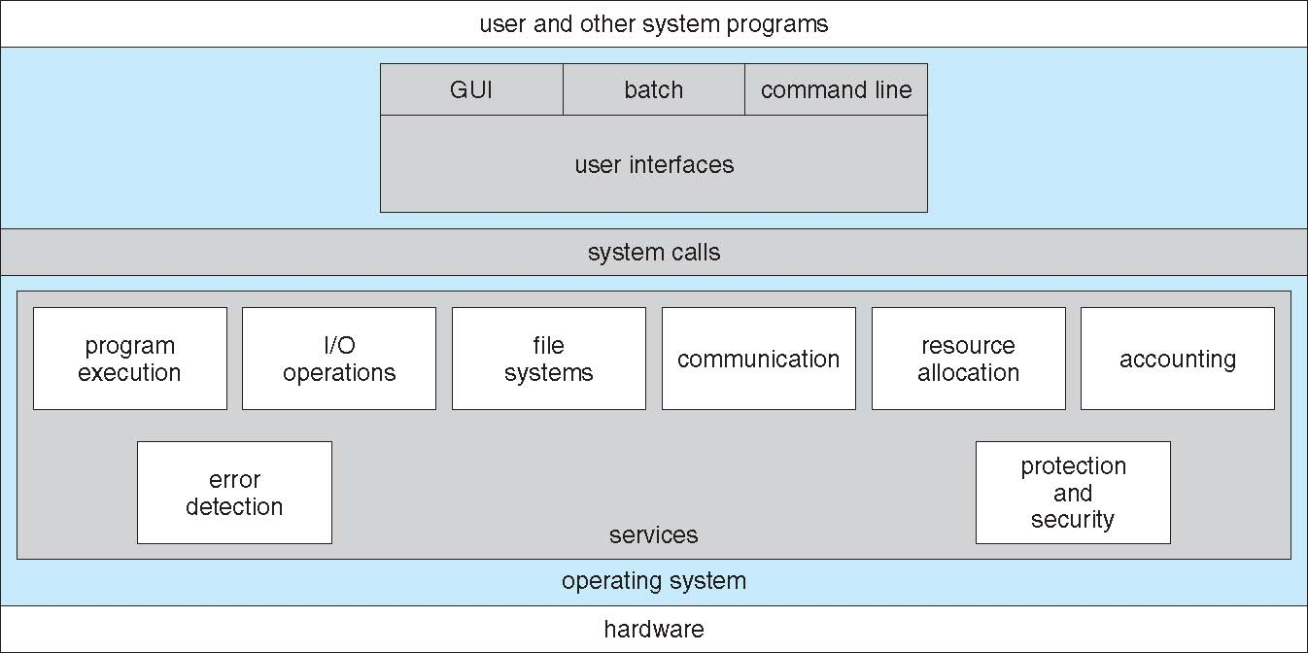
A View of Operating System Services

Slide 12
User Operating System Interface(CLI)
Two approaches for users to interface with OS: Command-line and Graphical User.
Command Line Interface (CLI) or command interpreter allows direct command entry
Sometimes implemented in kernel,
Others (Windows, Xp) treat command interpreter as a special program that is running when user first logs on.
Sometimes multiple flavors implemented – shells
(E.g. Bourne shell, C shell, Bourne-Again shell, Korn shell in Unix and Linux)
Main function of command interpreter is to get and execute the next user-specified command.
Mostly manipulate files (copy, delete, edit, list etc)

Slide 13
User Operating System Interface(CLI)
Two approaches to implement commands.
Command interpreter itself contains code to execute command.
Number of commands determine size of command interpreter since each command has its own code.
Implement commands through system programs (in UNIX)
Command interpreter does not understand the command.
It only identifies the file to be loaded in memory and execute
E.g. rm file.txt: The code to implement rm command will be in file rm.

Slide 14
User Operating System Interface - GUI
User-friendly desktop metaphor interface
Usually mouse, keyboard, and monitor
Icons represent files, programs, actions, etc
Various mouse buttons over objects in the interface cause various actions (provide information, options, execute function, open directory (known as a folder)
Invented at Xerox PARC (1970s)
Became more common by Apple Macintosh (in 1980s)
Many systems now include both CLI and GUI interfaces
Microsoft Windows is GUI with CLI “command prompt MS DOS” shell
Apple Mac OS X as “Aqua” GUI interface with UNIX kernel underneath and shells available
Solaris is CLI with optional GUI interfaces (Java Desktop, KDE)
Design of useful and friendly user interface is not a direct function
Of the OS

Slide 15
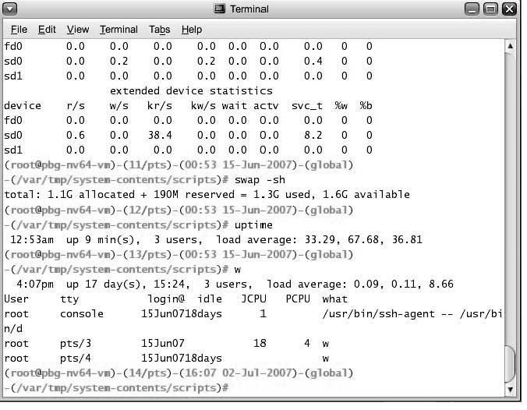
Bourne Shell Command Interpreter

Slide 16
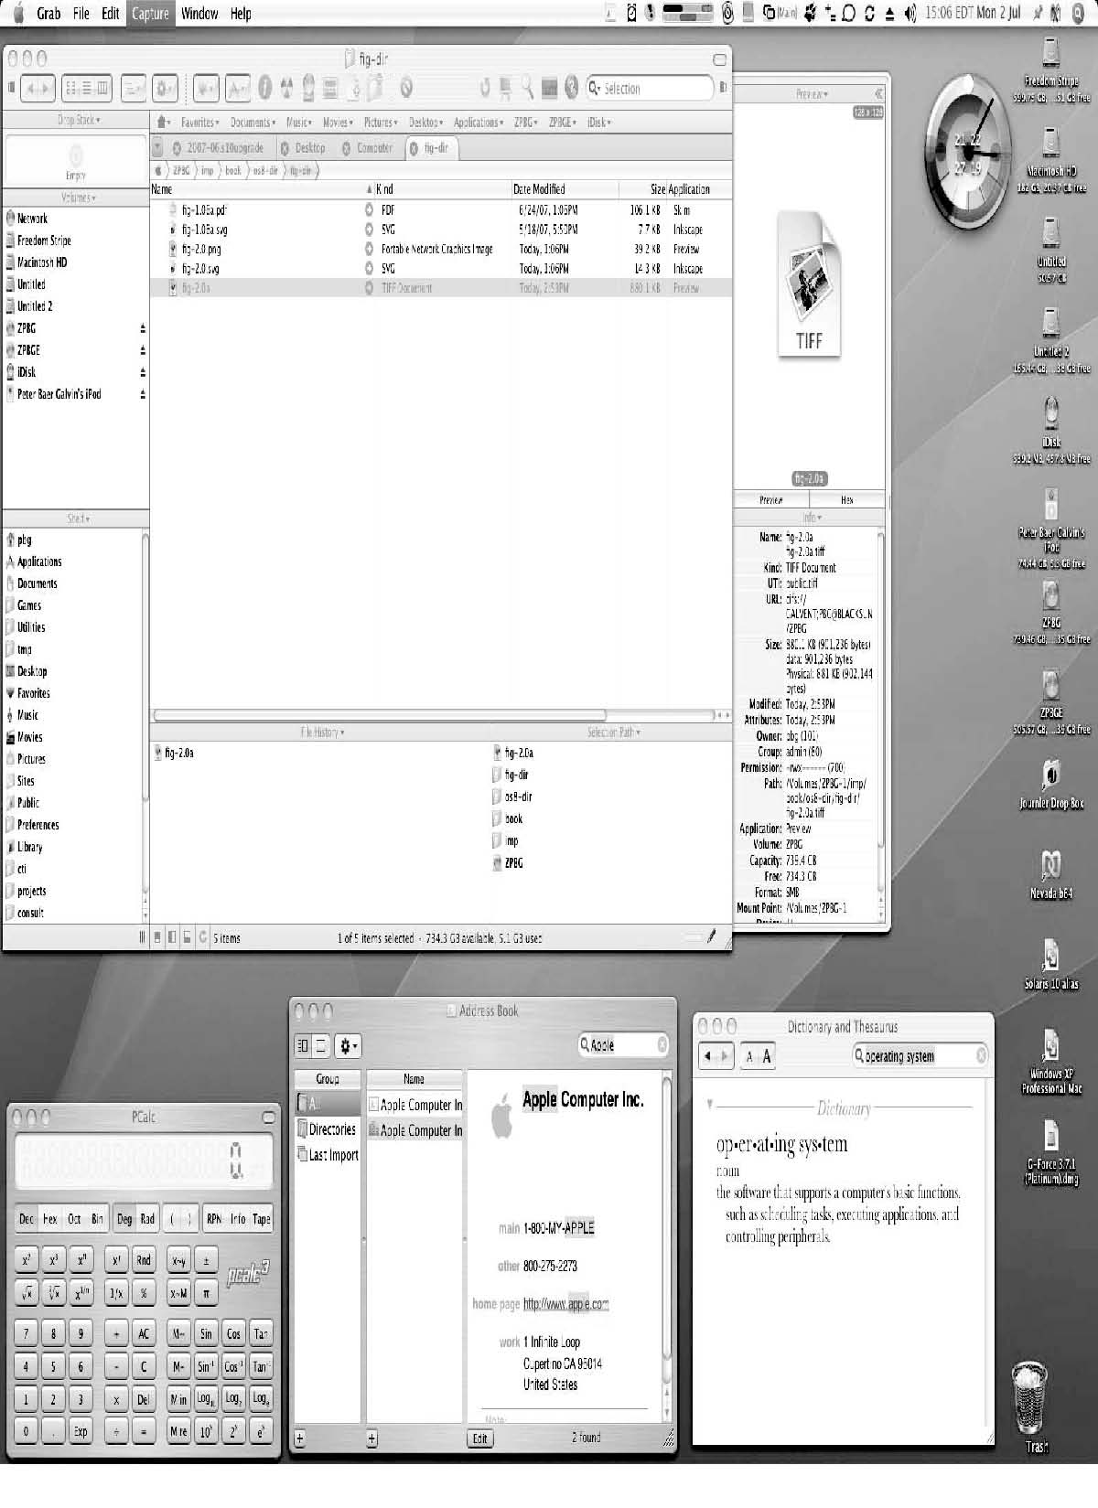
The Mac OS X GUI

Slide 17
System Calls
Programming interface to the services provided by the OS
Typically written in a high-level language (C or C++)
May require to be written in assembly language.
Example:
Copying a file from one location to other.
Mostly accessed by programs via a high-level Application Program Interface (API) rather than direct system call use
API specifies a set of functions with parameters and return types.
Three most common APIs are
Win32 API for Windows,
POSIX API for POSIX-based systems (including virtually all versions of UNIX, Linux, and Mac OS X), and
Java API for the Java virtual machine (JVM)

Slide 18
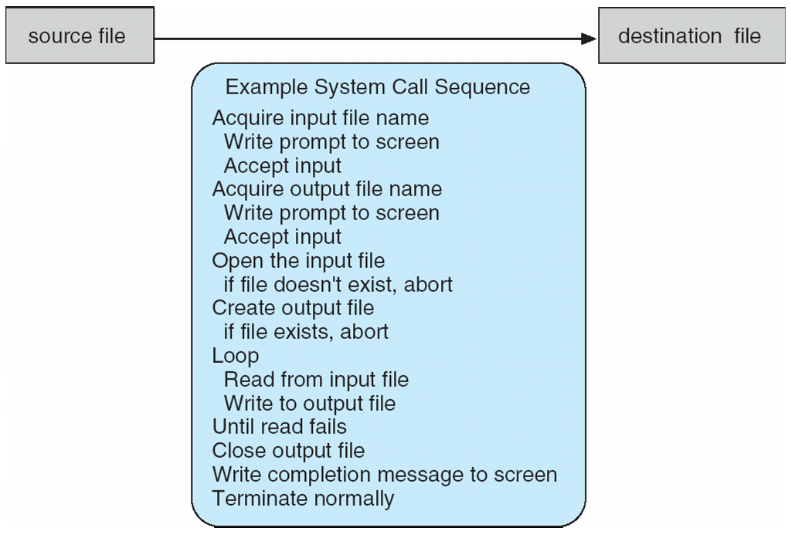
Example of System Calls
System call sequence to copy the contents of one file to another file

Slide 19
System Calls
Functions that make up an API typically invoke actual system calls on behalf of application programmer.
E.g. Win32 function CreateProcess() calls NTCreateProcess() system call in Windows Kernel.
Why use APIs rather than system calls?
Program portability
Difficulty/Complexity for programmer decreased
(Note that the system-call names used throughout this text are generic)

Slide 20
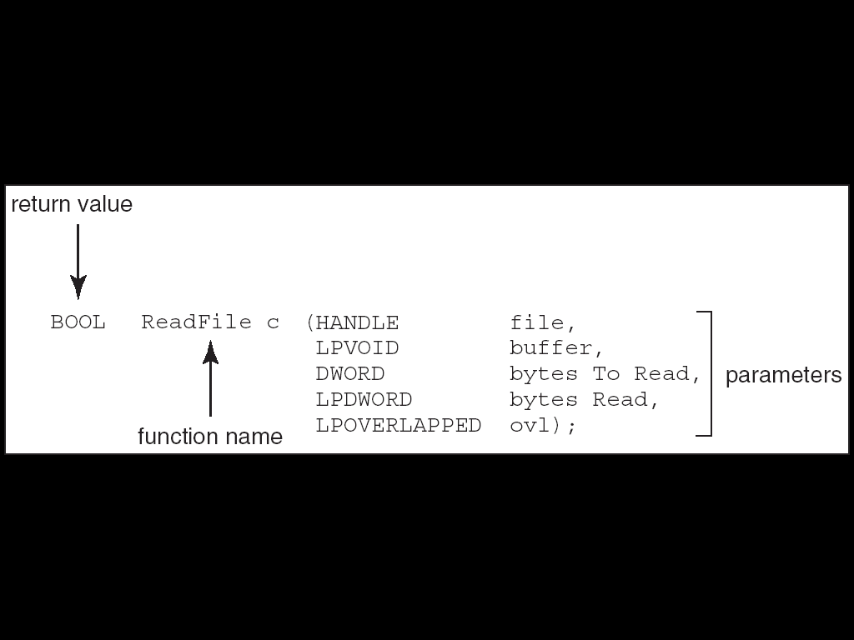
Example of Standard API
Consider the ReadFile() function in the
Win32 API—a function for reading from a file
A description of the parameters passed to ReadFile()
HANDLE file—the file to be read
LPVOID buffer—a buffer where the data will be read into and written from
DWORD bytesToRead—the number of bytes to be read into the buffer
LPDWORD bytesRead—the number of bytes read during the last read
LPOVERLAPPED ovl—indicates if overlapped I/O is being used

Slide 21
System Call Implementation
Typically, a number associated with each system call
System-call interface (SCI) maintains a table indexed according to these numbers.
SCI invokes intended system call in OS kernel ad returns status of system call and may return values.
The caller need know nothing about how the system call is implemented
Just needs to obey API and understand what OS will do as a result call
Most details of OS interface hidden from programmer by API
Managed by run-time support library (set of functions built into libraries included with compiler)

Slide 22
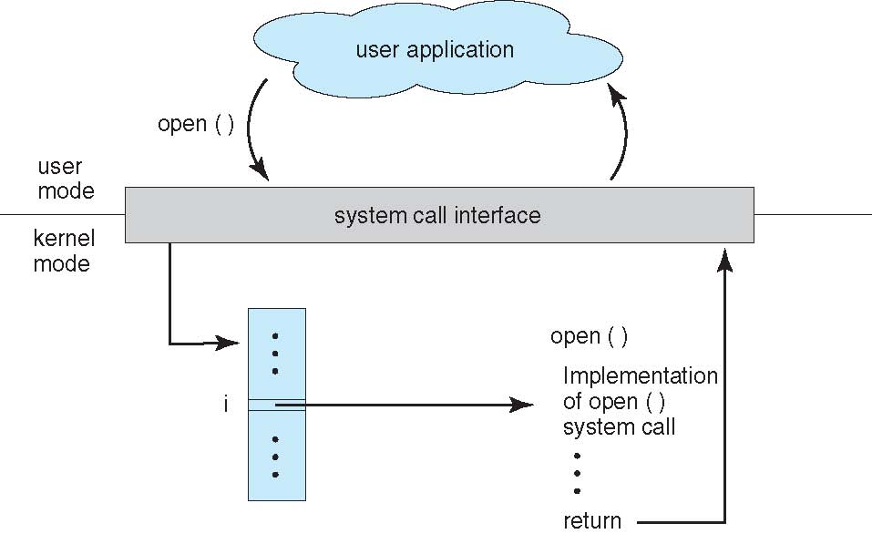
API – System Call – OS Relationship

Slide 23
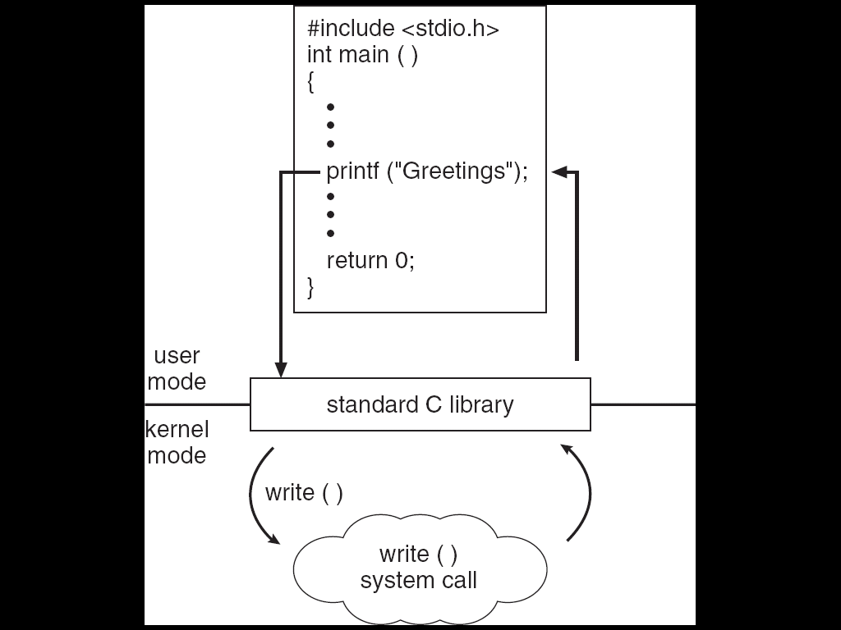
Standard C Library Example
C program invoking printf() library call, which calls write() system call

Slide 24
System Call Parameter Passing
Often, more information is required than simply identity of desired system call
Exact type and amount of information vary according to OS and call
Three general methods used to pass parameters to the OS
Simplest: pass the parameters in registers
In some cases, may be more parameters than registers
Parameters stored in a block, or table, in memory, and address of block passed as a parameter in a register
This approach taken by Linux and Solaris
Parameters placed, or pushed, onto the stack by the program and popped off the stack by the operating system
Block and stack methods do not limit the number or length of parameters being passed

Slide 25
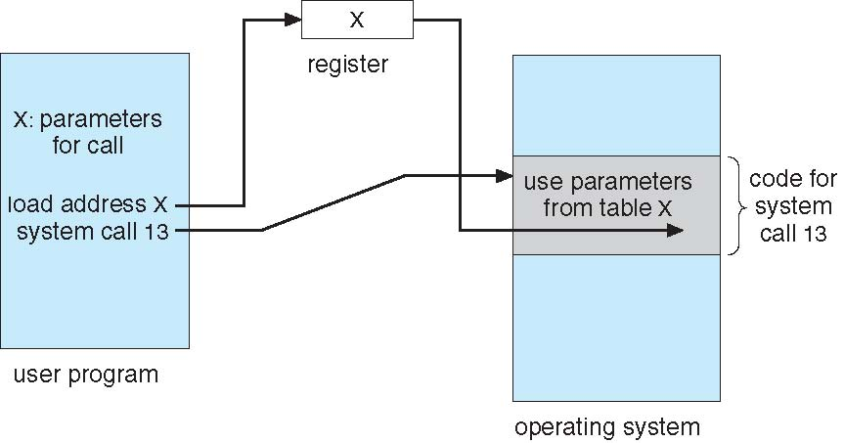
Parameter Passing via Table

Slide 26
Types of System Calls
Process control
Process Ends (normally), aborts (end abnormally)
Dump to Hard disk. Error message. May be examined by debugger.
OS shifts control to command interpreter (user gives next command to deal with it or a message on pop up window).
Determine error level based on normal or abnormal termination.
Load, execute (another program)
Control back to executing program
Create process, terminate process
Get process attributes, set process attributes control priority, max allowable execution time)
Wait, wait for time wait event, signal event
Lock share data
Acquire lock, release lock.
Allocate and free memory

Slide 27
Example: MS-DOS
Single-tasking
Shell invoked when system booted
Simple method to run program
No process created
Single memory space
Loads program into memory, overwriting all but the kernel
Program exit -> shell reloaded

Slide 28
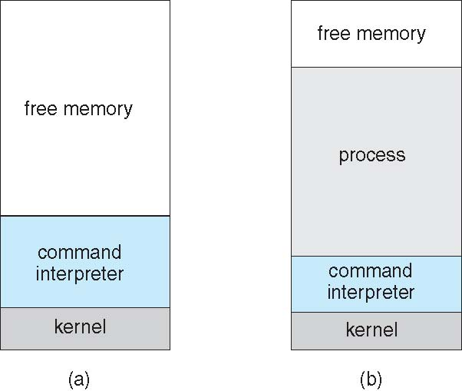
MS-DOS execution
(a) At system startup (b) running a program

Slide 29
Example: FreeBSD
Unix variant
Multitasking
User login -> invoke user’s choice of shell
Shell executes fork() system call to create process
Executes exec() to load program into process
Shell waits for process to terminate or continues with user commands
Process exits with code of 0 – no error or > 0 – error code

Slide 30
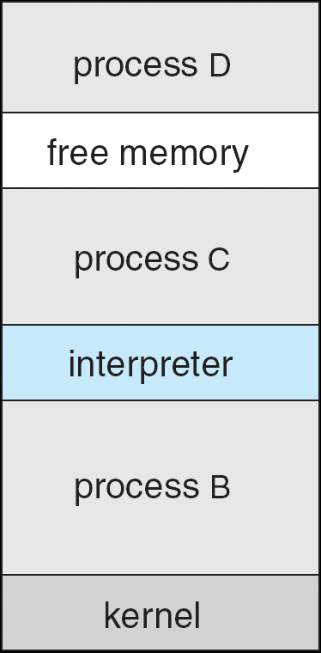
FreeBSD Running Multiple Programs

Slide 31
Types of System Calls (contd..)
File management
create file, delete file
open, close file
read, write, reposition
get and set file attributes

Slide 32
Types of System Calls (Cont.)
Device management
request device, release device
read, write, reposition
get device attributes, set device attributes
logically attach or detach devices
Information maintenance
get time or date, set time or date
get system data, set system data
get and set process, file, or device attributes
Communications
create, delete communication connection
send, receive messages
transfer status information
attach and detach remote devices

Slide 33
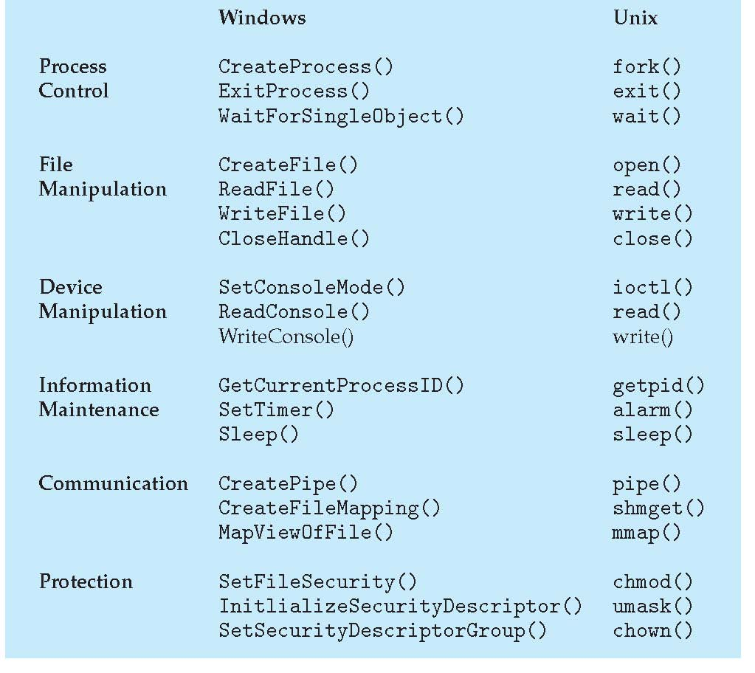
Examples of Windows and Unix System Calls

